Slide 1
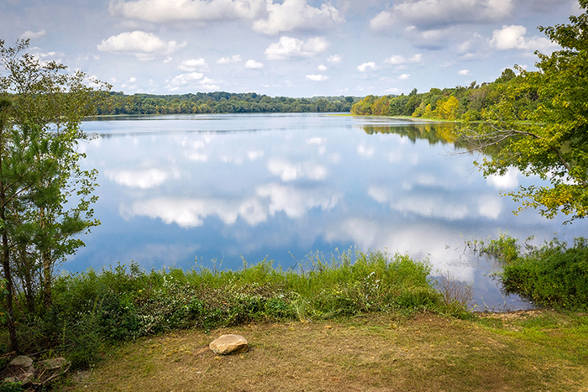
Henrico:
Bullish About a New Tomorrow
June 10, 2021
Anthony J. Romanello
Warren Whitney Leadership Network

Slide 2
Henrico EDA: What We Do
Grow Henrico's economy for all
Do our part to help the County
My Job Description:
Salesperson
Cheerleader
Marriage Counselor
Convener
Possibility Awakener
Concierge
Teambuilder
Tapestry Weaver
Growing Henrico’s Economy For All
1

Slide 3
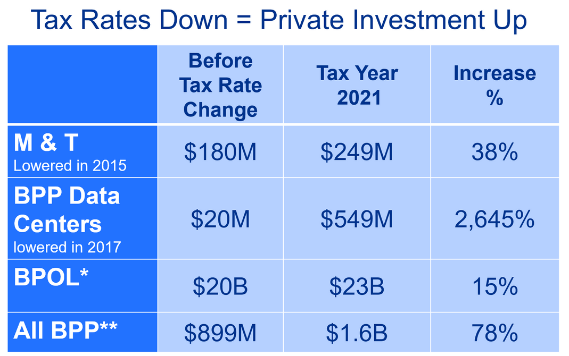
How We Measure Success:
Data Center Tax Revenue Up 600% in 4 Years
Gross County Product:
$27 Billion,#3 in Virginia
March 2020 – May 2021
3.5M Sq. Feet
2,277 New Jobs, 780 Retained
$154M in Wages
$501.3M Investment
Growing Henrico’s Economy For All
2

Slide 4
Recent Wins:
AG21 Health Sciences
Growing Henrico’s Economy For All
3

Slide 5
Growing Henrico’s Economy For All
4

Slide 6
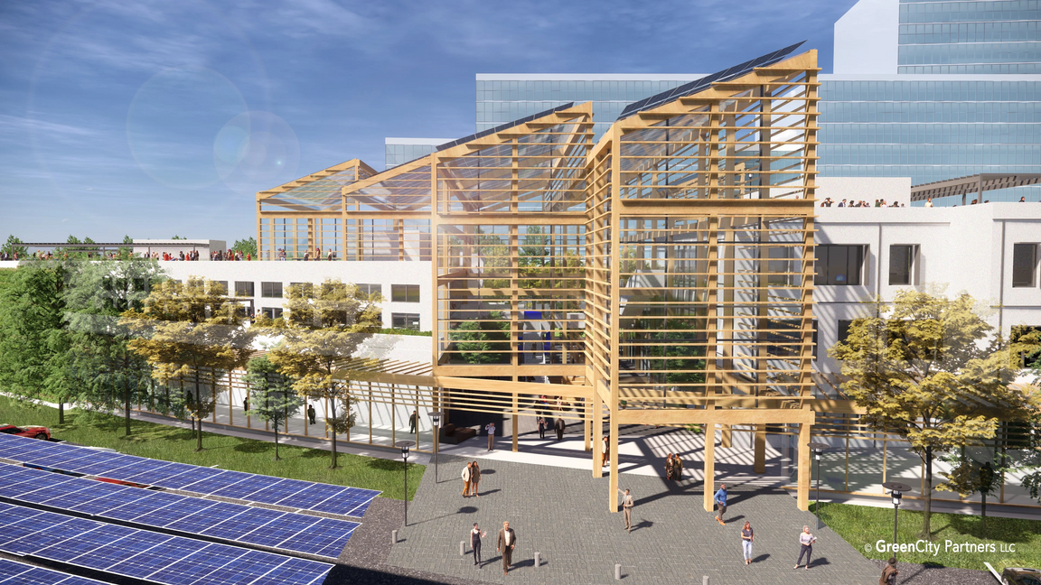
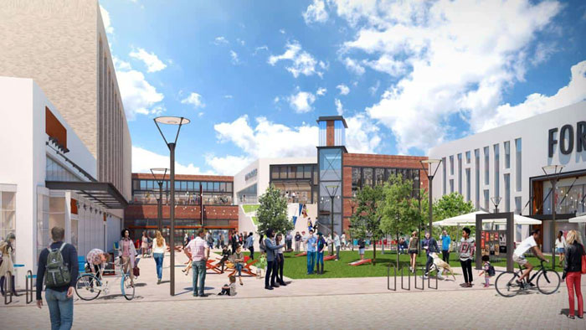
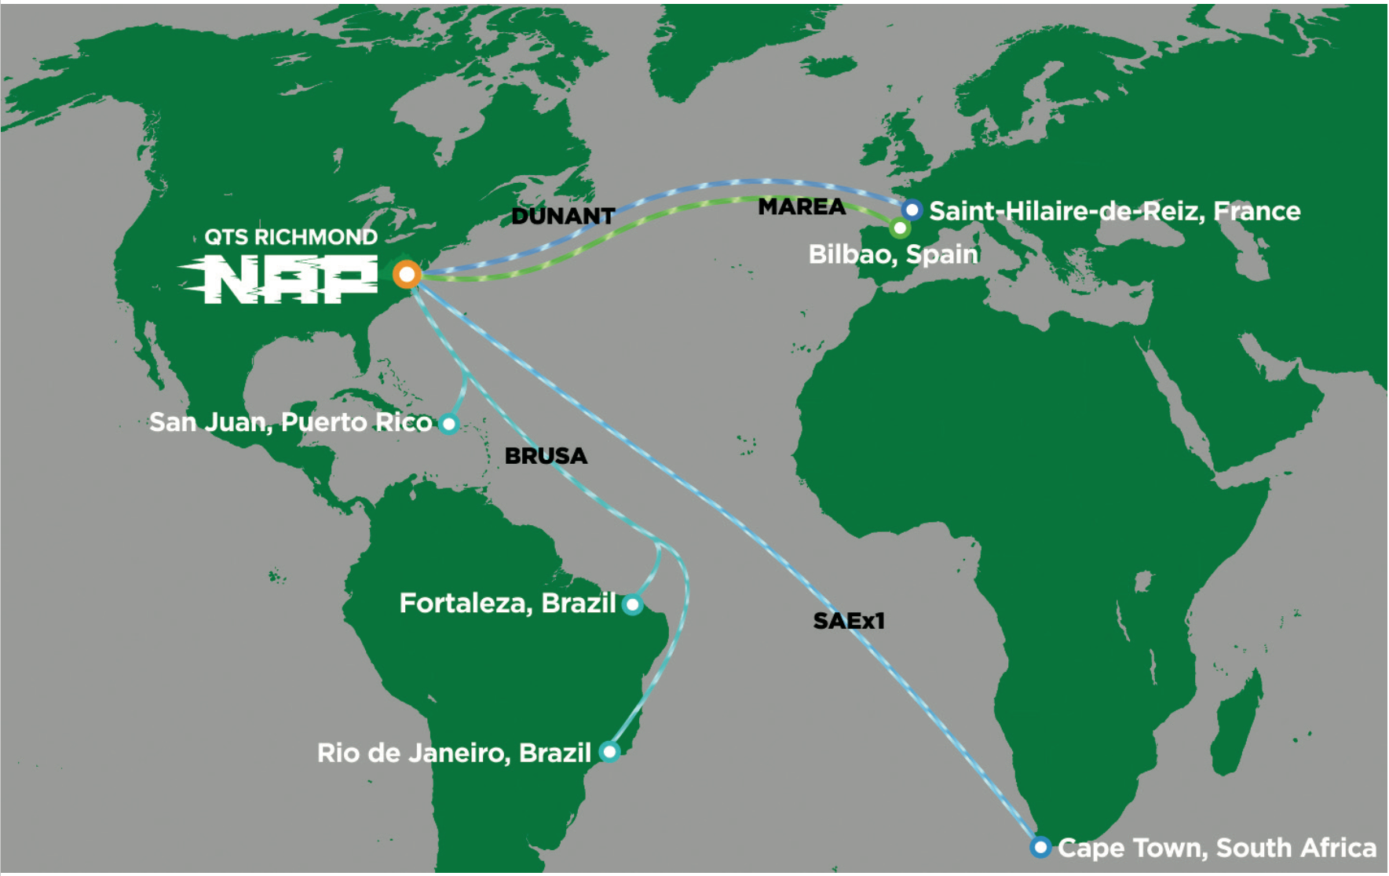
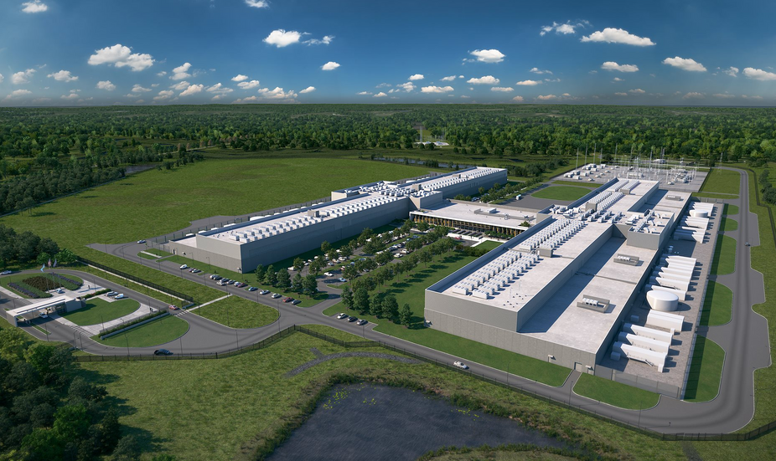
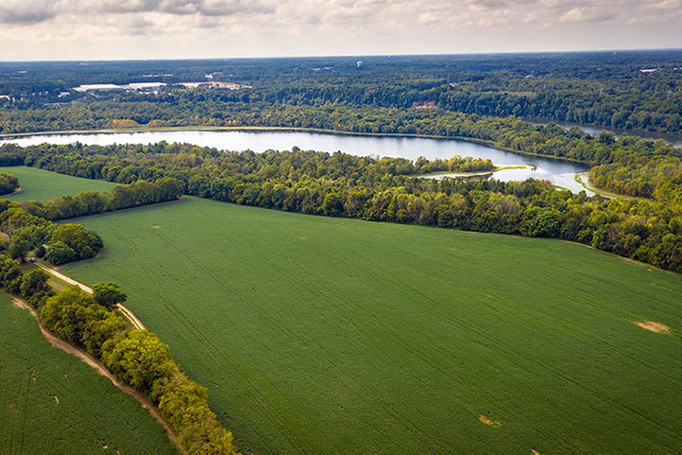
Exciting Developments
Growing Henrico’s Economy For All
5

Slide 7
Big Questions: A New Tomorrow
The Coronavirus is a public health hurricane that caused an economic tornado. As this tempest of wicked winds calms, our world is forever changed. If recovery is defined as the act of returning to normal, waiting for recovery is folly. This is A NEW TOMORROW. Some big questions we are asking:
WHAT IS THE FUTURE OF PEOPLE SPACE?
WHAT IS THE FUTURE OF BRICK-AND-MORTAR RETAIL?
3
CAN AMERICA BECOME A MANUFACTURING CENTER AGAIN, PARTICULARLY FOR PHARMACEUTICALS, SEMICONDUCTORS, AND MEDICAL SUPPLIES & PPE?
1
2
3
Will jobs be chasing people instead of people chasing johs?
Will resumes have addresses anymore?
In a hybrid/WFH world, what are the implications for the nurturing of teams and organizational culture?
WHAT IS THE FUTURE OF PRESENTATIONS AND BUSINESS TRAVEL?
WHAT WILL WE DO IN THE FUTURE THAT WE DIDN'T DO BEFORE THE PANDEMIC?
6
HOW DO WE CONNECT WITH EVERYONE?
4
5
Growing Henrico’s Economy For All
6

Slide 8
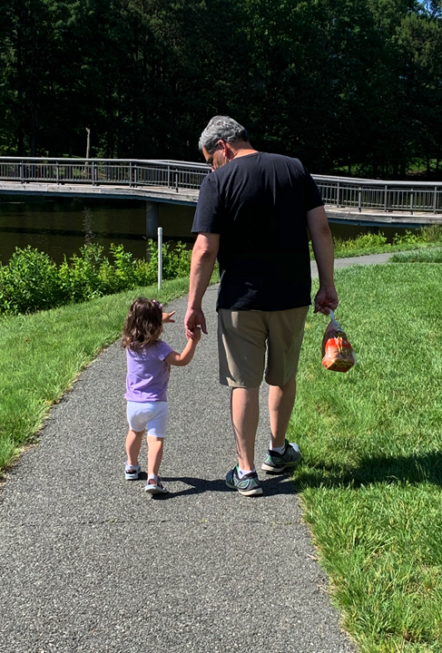
Random Thoughts from a Middle-Aged Guy
Listen with both ears and both eyes.
Curiosity is a virtue - ask lots of good questions.
A.I. is no substitute for R. E. (real empathy) - only people can discern, create, care, and bring to life.
Ask daily - who is my neighbor and how can I serve?
Re-discover the familiar – again and again.
Growing Henrico’s Economy For All
7

