Slide 1
Virtual ENGAGEMENT in a covid-19 world
Rich arnold
703.932.6319 RichArnold1982@gmail.com

Slide 2
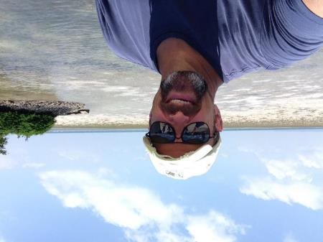
introductions
Rich Arnold
24 years USCG and USN
20+ years project work: Africa, FSU, Asia, SW Asia, South America, Pacific Islands for DTRA, DOE, Dept of State, Military, UN, NGOs
Large – Small firm executive leader experience
Former Adjunct Faculty, Old Dominion University
Please participate:
Feel free to pop a question in chat or just ask
Q&A period at the end of the session
1= Got it / Agree 2= Fuzzy / Unsure 3= Disagree
Good Morning Leaders!
My Virtual World This Week:
Energy workshop for Zambia
Virtual team project for USAID
Training course for DOE Los Alamos
VA IDIQ team business development
Florida wellness development center
Client meetings

Slide 3
Your ENGAGEMENT in a virtual world
Ask Yourself:
What are your virtual team’s strengths and weaknesses?
Are you effectively communicating your goals/objectives in a virtual setting? If so, how are you accomplishing this? If not, what can you do to better?
What can you do to develop a better understanding of your virtual interactions?
Are virtual interactions about dialogue and task-focused ---- or “briefings” with little interaction / output focus?
Is collaboration timely, effective and two-way?

Slide 4
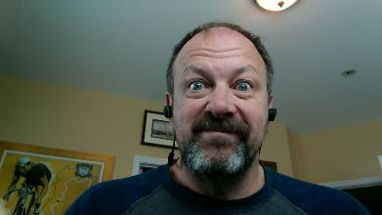
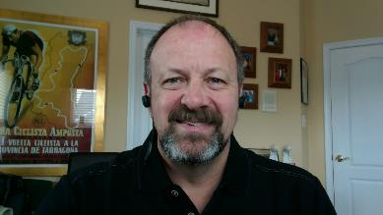
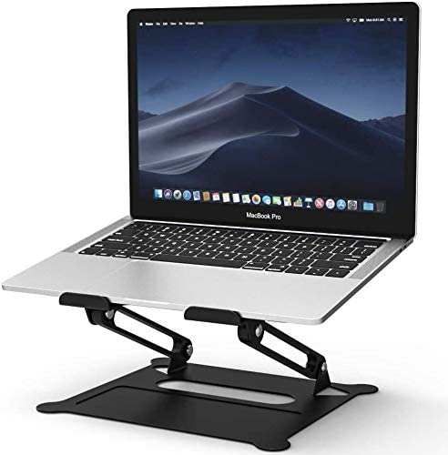
Camera and presentation station Tips
LOOK AT THE LENS!
“The Ugly Shot”: Camera below eye level
Check lights (front of face), camera focus, position, and appearance
Look professional (at least on-camera part)
Check background for anything inappropriate
Audio Prep:
Microphone: Digital Headset / Test Audio
Avoid Background Noise
What’s wrong with this setup?
Anything better about this one?
Place lens at eye level with a stand or use a separate camera to avoid… The Ugly Shot

Slide 5
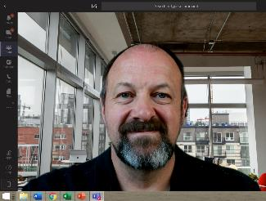
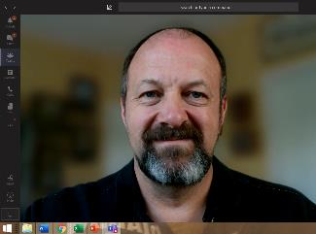
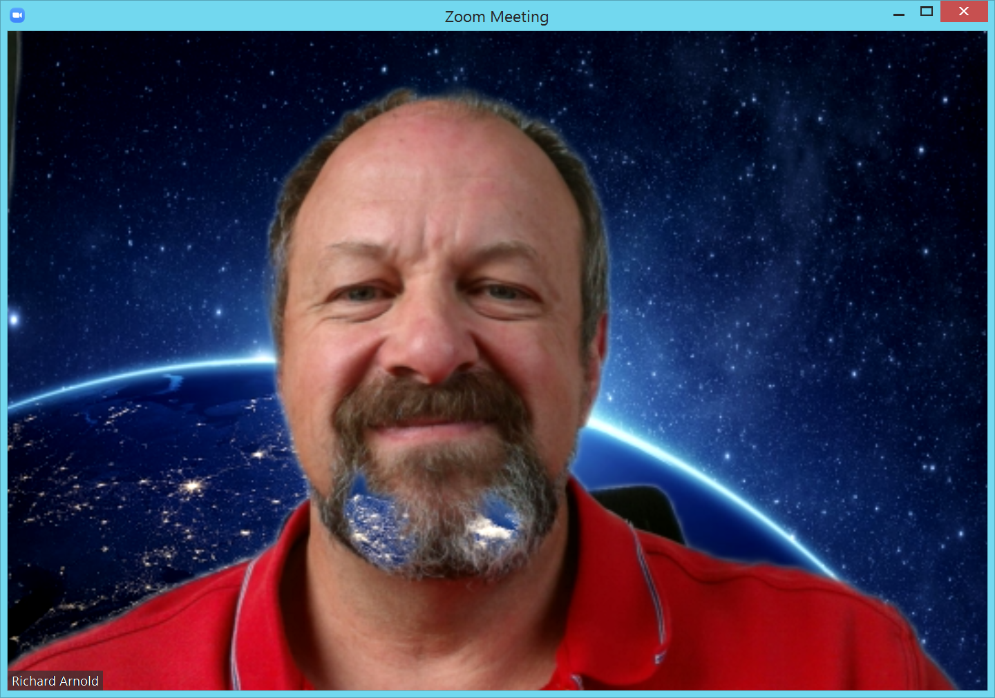
Camera and presentation STATION Tips
Use “Blur” or background function if available
“Pause” video if you need to look away
Contacts if you have them / check for glasses reflection
No distracting jewelry
Use of hands and idiom
Be careful with split monitors!
Camera: Eye Level + Lighting: Front of Face + Blur: No Issues

Slide 6
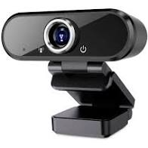
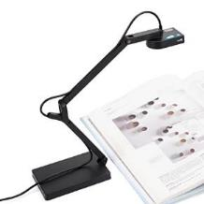
Camera and presentation station Tips
Alternate to laptop camera:
Use a web cam
Adapt cell phone as a web cam IVCam: https://www.e2esoft.com/ivcam/
Build/Buy a stand to enable vertical focus on any object you need to manipulate or display for demonstration purposes
Set a target spot where you manipulate the tool or perform the function

Slide 7
Virtual COLLABORATION Tools – BE FLEXIBLE
Practice with the Tools
Installed Apps usually more functional & more effective than web version
Don’t make a virtual meeting a phone call…use tools to make it collaborative
Chat + Verbal for dialogue
Annotation, collaborative drafting, screen grabs
Video – Not Video?
Use technology agnostic methods
Job aides and assistance
“Block Zero” to test channels and tools before diving into content with clients

Slide 8
VIRTUAL ENGAGEMENT - BE personal
Break down the anonymous look and feel of a virtual session
Personalize an Impersonal Environment
Use names as much as possible
Recognize & Thank respondents
Be positive, even when correcting
Mix overhead (group) & direct (by name) verbal and chat questions

Slide 9
VIRTUAL ENGAGEMENT – MEANINGFUL INTERACTION
Don’t Brief or Lecture: Question and Interact
Boost interaction during virtual sessions
Use questions to boost dialogue and attention
Group and Individual
Open and Closed
Multichannel the questions
Polling w/embedded tools
Pull formative & summative thoughts and ideas

Slide 10
VIRTUAL ENGAGEMENT: REPLACE NONVERBALS
Don’t depend solely on the Camera
Interact / Engage
60+% of communication is nonverbal
Cameras…especially in groups…are poor at conveying nonverbals + “Zoom Fatigue”
Use Dynamic Vocals
Polling + Chat + Whiteboards + Annotation tools
“Pull” style Questions

Slide 11
VIRTUAL networking – building bridges
Can we network in this environment?
Fostering Networking
N/A: Interaction over coffee service & other typical events
Provide an intro segment
Sponsor tighter mini-network events or small groups
“Starter” topics and questions to identify potential alignments on needs / solutions / ideas
Virtual breakout rooms / areas for small groups
Opportunities to demonstrate understanding

Slide 12
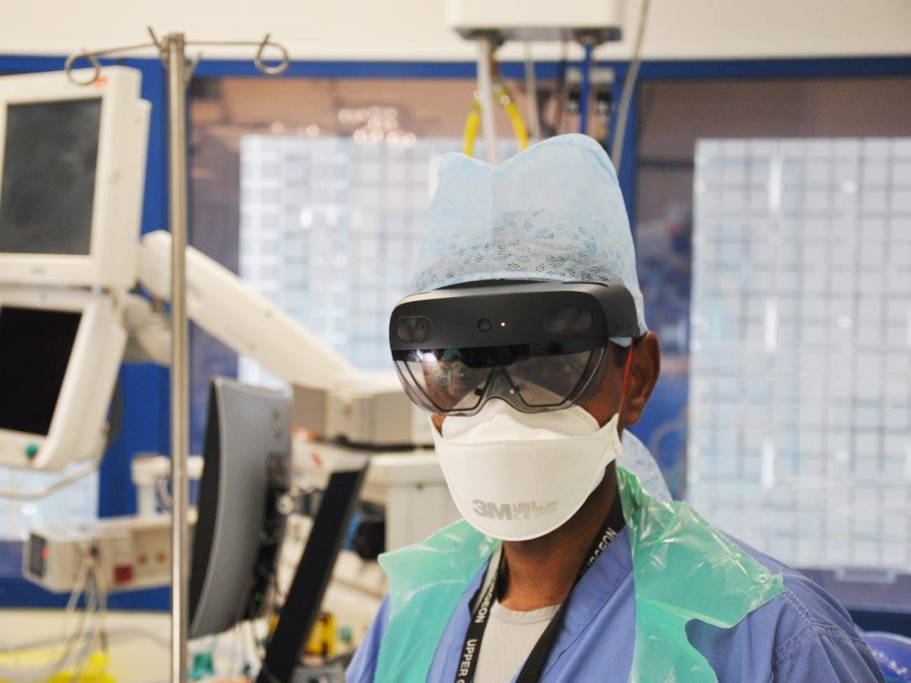
VIRTUAL NETWORKING – THE ART OF THE POSSIBLE
Can we do Virtual Networking?
True Virtual Meetings
Leverage Augmented or Mixed Reality
Buy/Rent Common System
True Virtual Presence
Connected via a Meeting or Collaboration System
https://www.businessinsider.com/london-doctors-microsoft-hololens-headsets-covid-19-patients-ppe-2020-5
Notes:
A small number of London hospitals have given out 10 mixed-reality headsets to doctors as a way to reduce the amount of hospital staff coming into contact with COVID-19 patients.
The headsets, called the HoloLens, are built by Microsoft and allow doctors to share their POV with colleagues remotely, while also showing holographic projections to the doctor wearing the headset.
Dr. James Kinross, one of the doctors using the headsets, told Business Insider this means instead of six or seven doctors conducting a ward round, just one can go into the physical ward while the rest remain in a COVID-isolated room.

Slide 13
Summary
Make your engagements, meetings and outreach programs two-way…not “typical” one-way passive webinars
Focus on realistic and measurable goals and objectives
Make the environment personal and engaging by focusing on people and their needs, not bells and whistles
Don’t let unconscious choices about scheduling, logistics, types of engagements drive your virtual program
Provide solid tech and back up support until you develop system competency…but focus on technology agnostic methods
This is not a choice of face-to-face OR virtual engagement…make it AND…

Slide 14
Contact information
Rich Arnold
RichArnold1982@gmail.com
703.932.6319
Notes:
Instructor Notes: Review slide with participants. After ~5 minutes, pick one or two impactful/informational team player inventories to briefly discuss with the class.
Simply being aware → aware of your strengths and weaknesses → aware of your team’s goals → aware of your teammates’ motivations → will make you a stronger team player. The next step is knowing and embracing your role and responsibilities, as well as those of your teammates.
Note to participants that they can recover their chats in a saved file after the session for reflection or additional consideration. (CHECK THIS FEATURE DURING PRACTICE)

